Slide 1


Slide 2


Slide 3


Slide 4


Brain storming

Slide 5
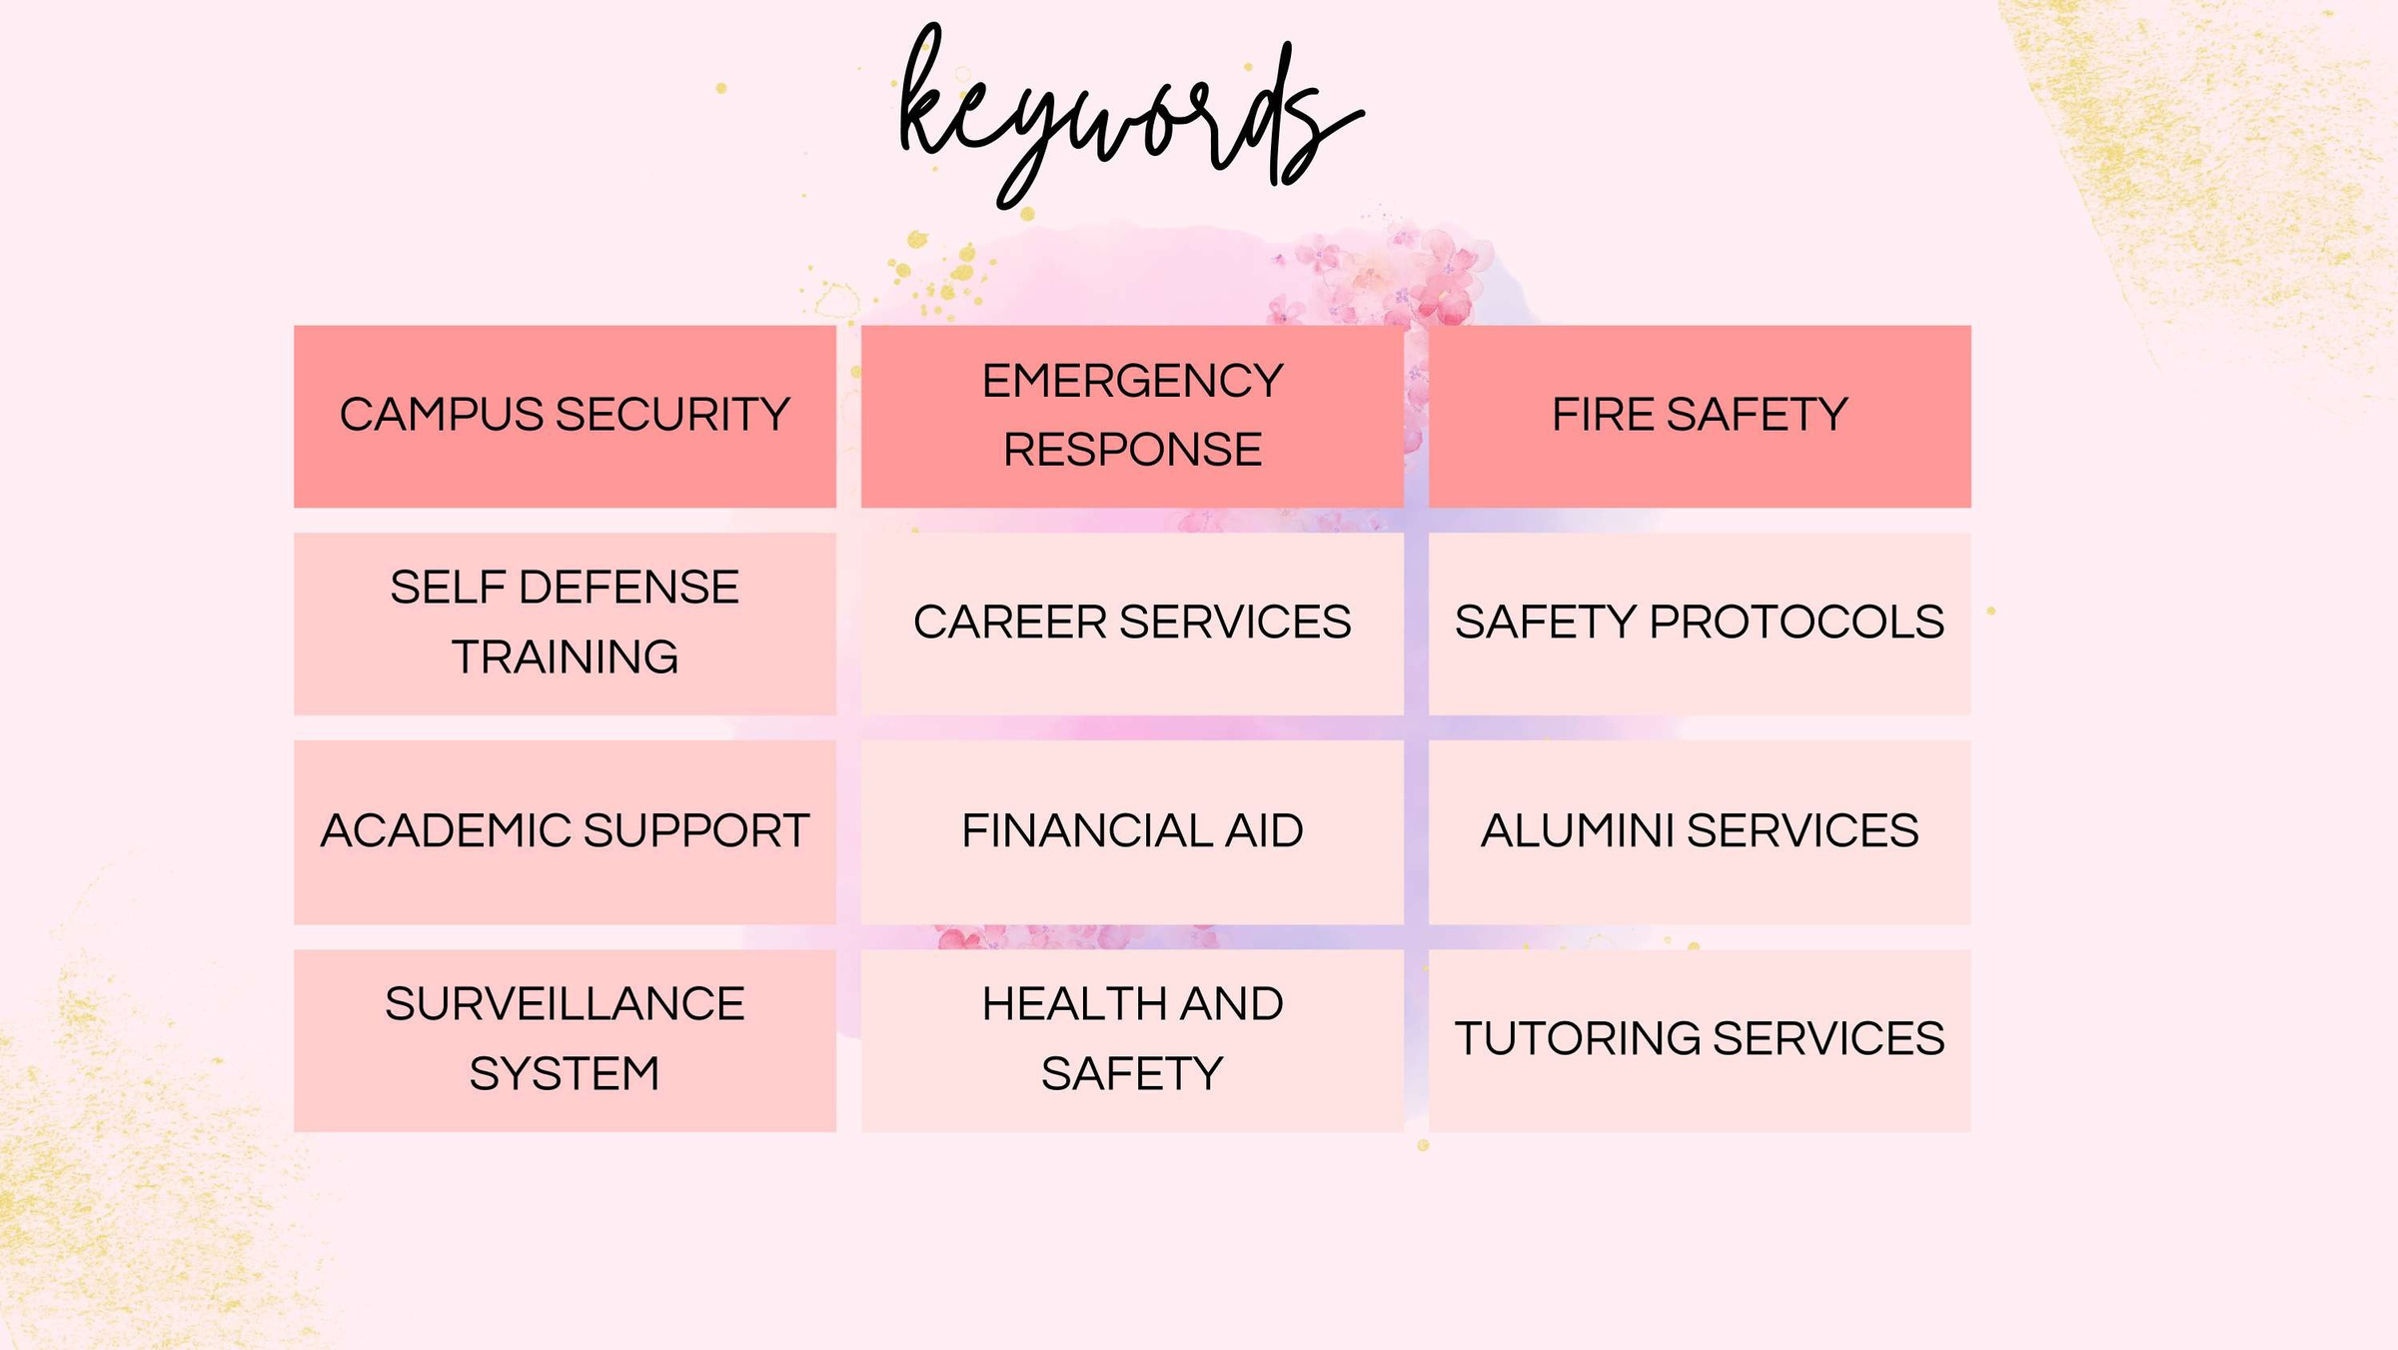

Slide 6
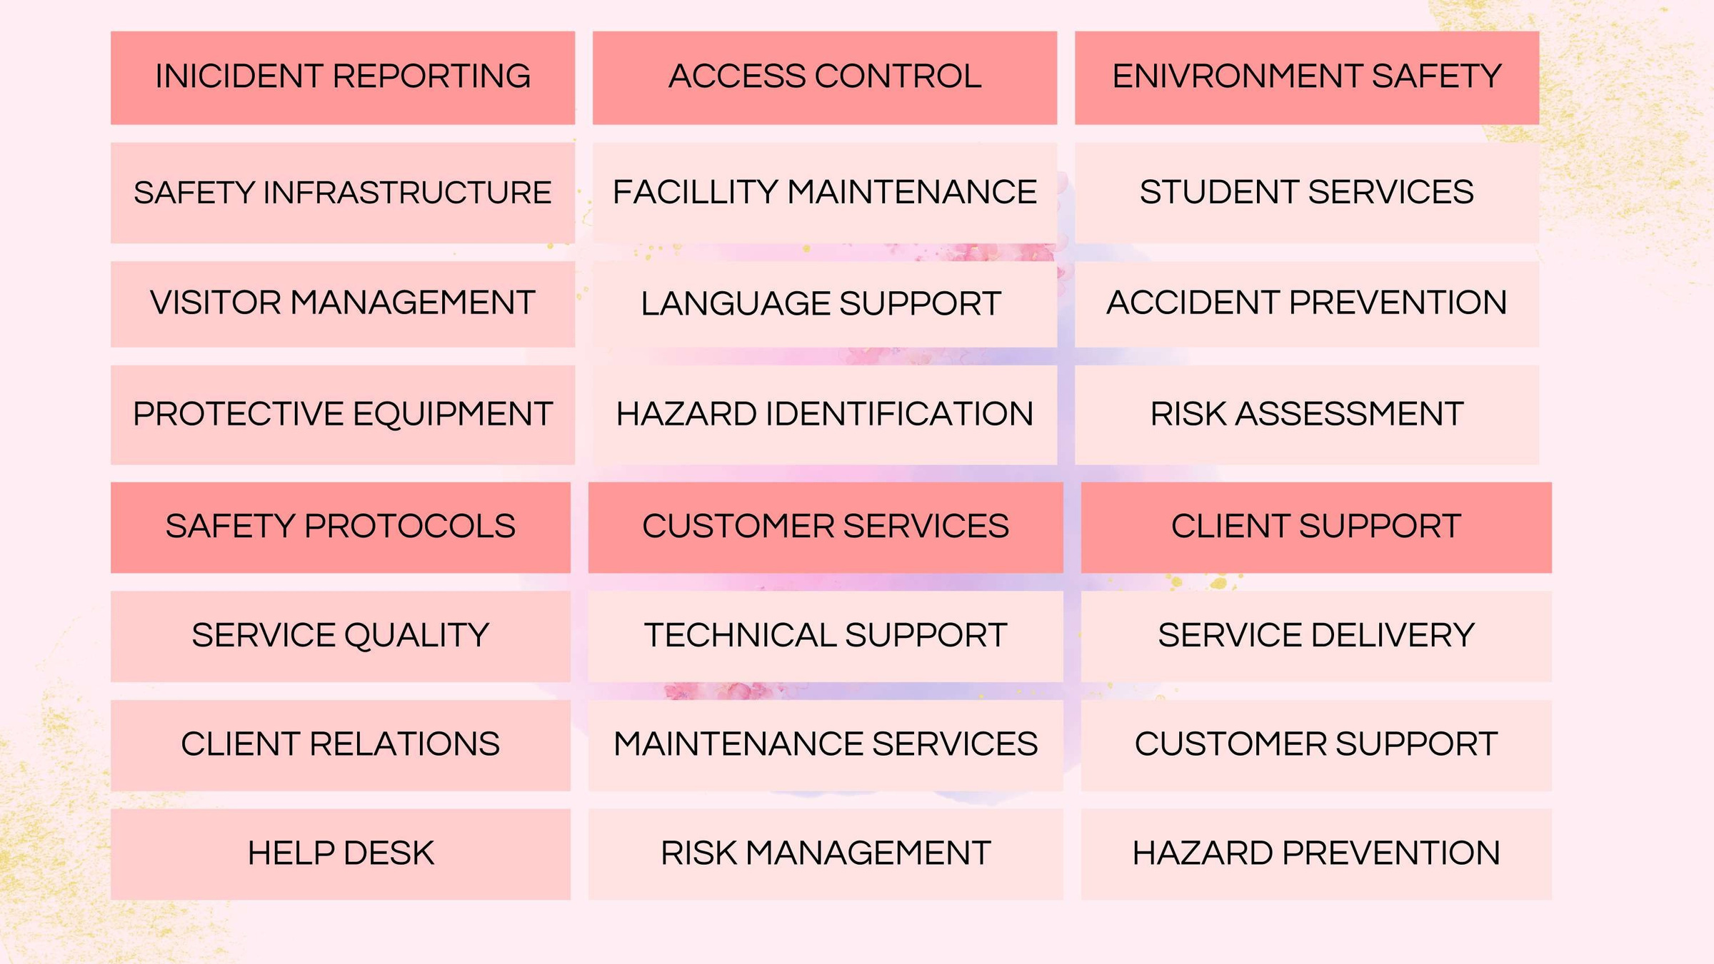

Slide 7
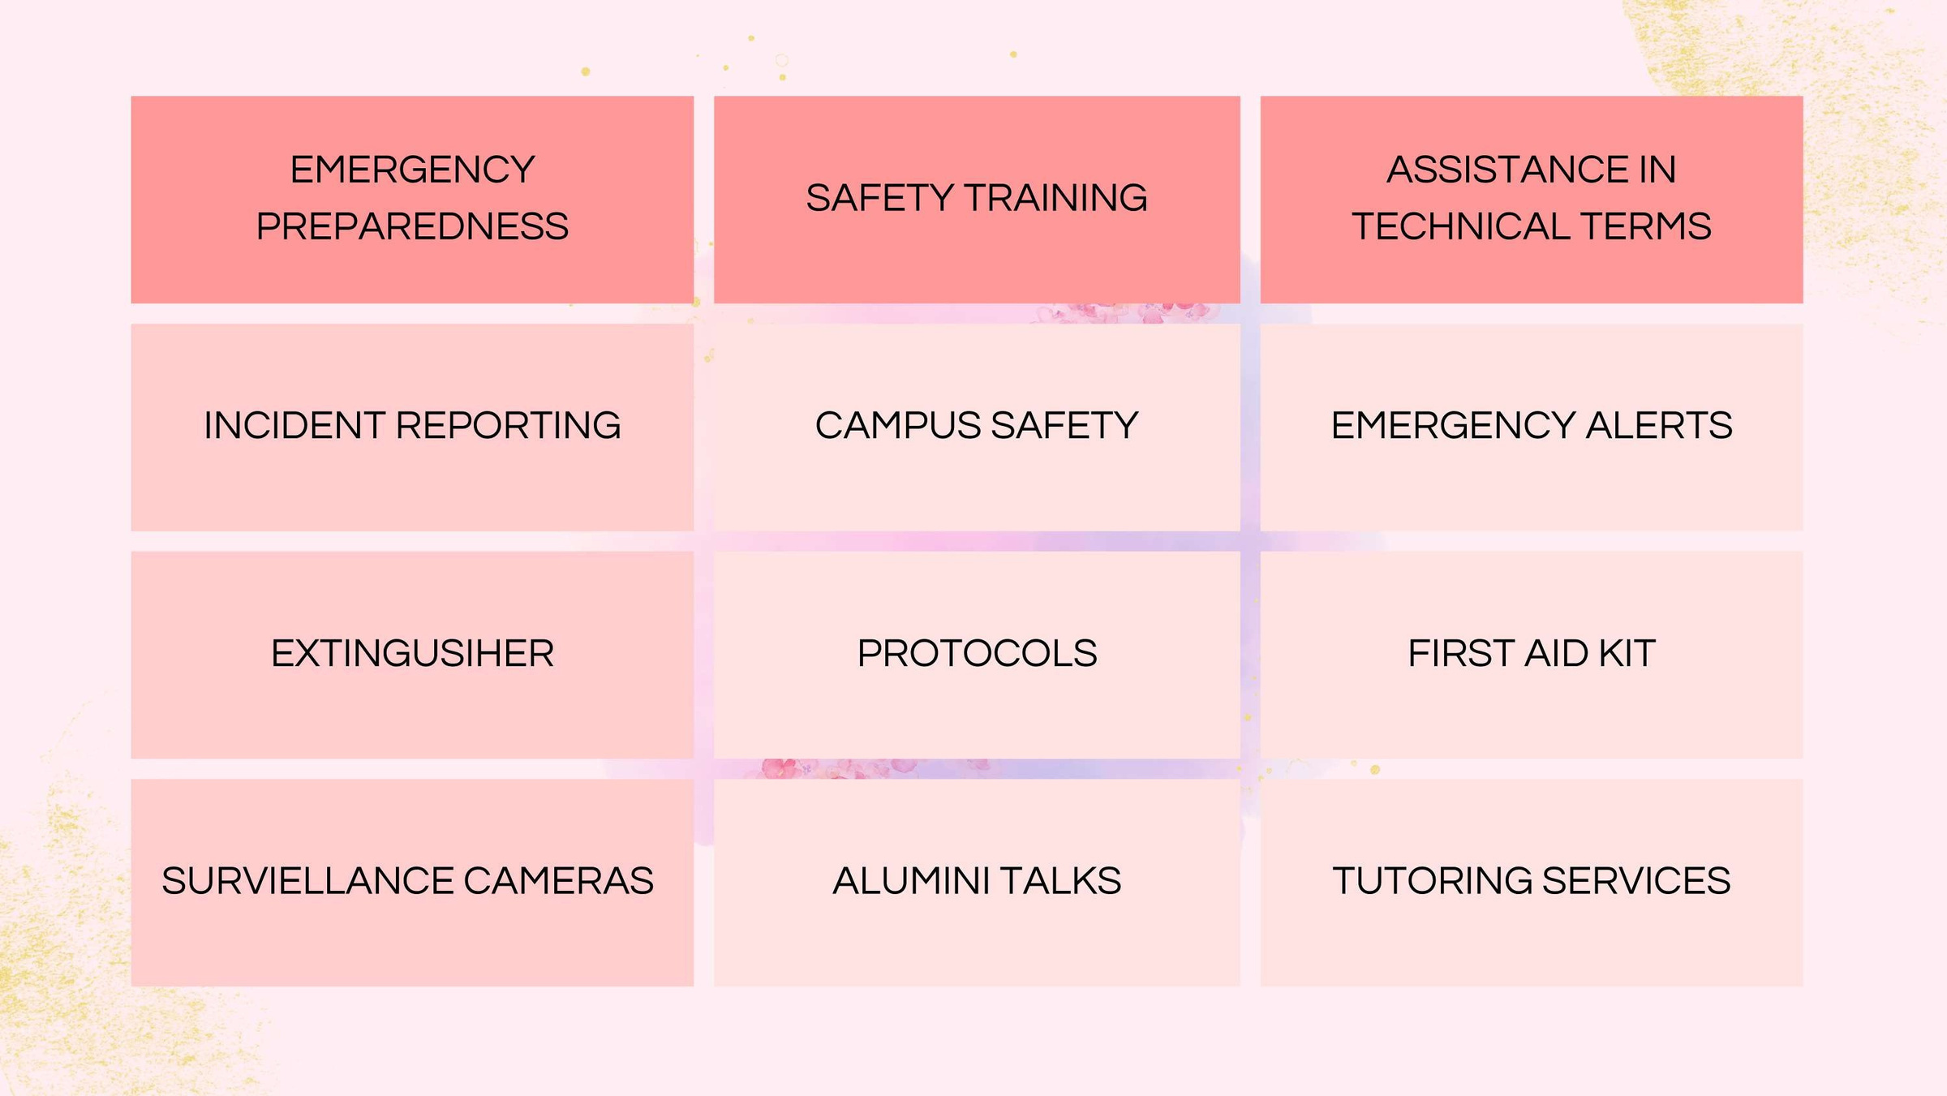

Slide 8


Slide 9
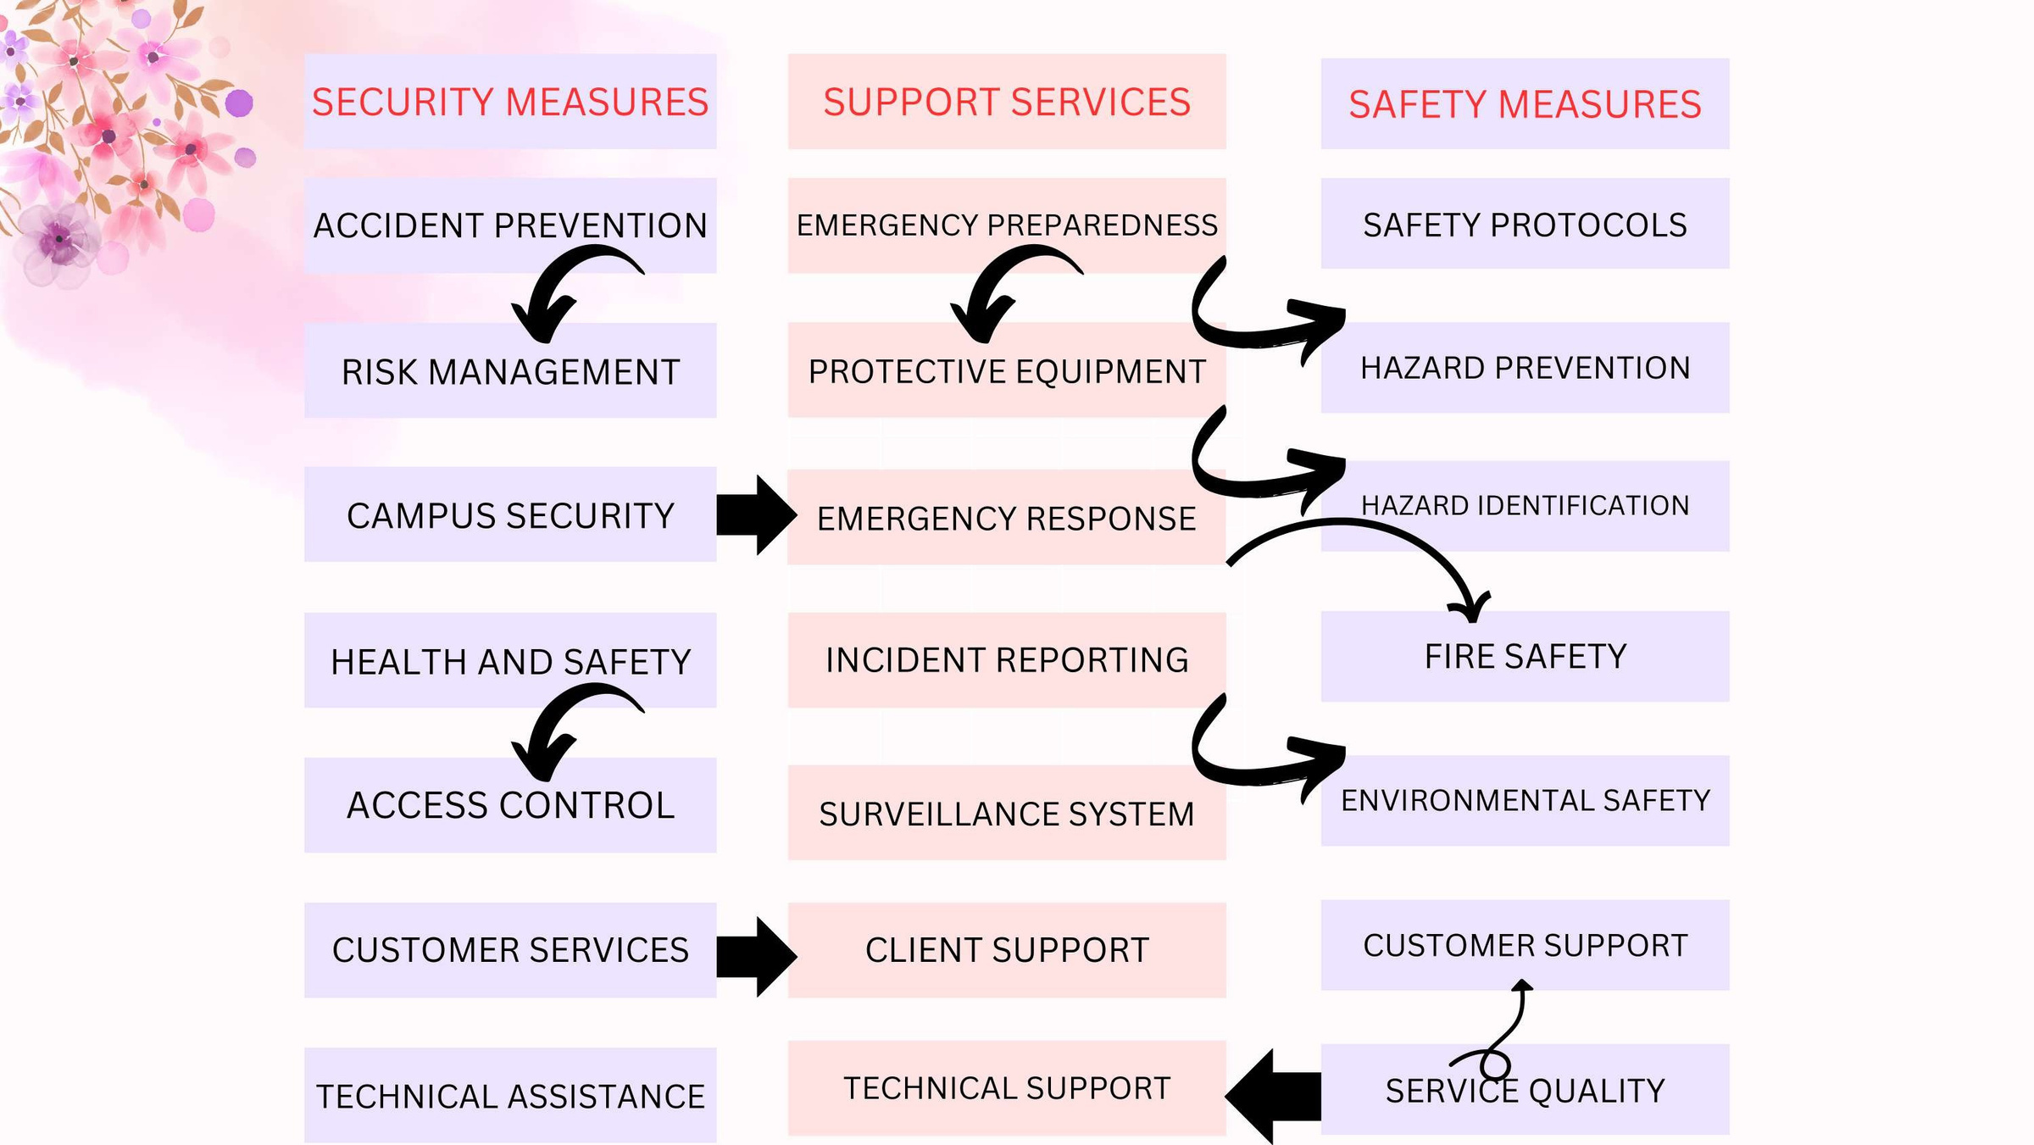

Slide 10
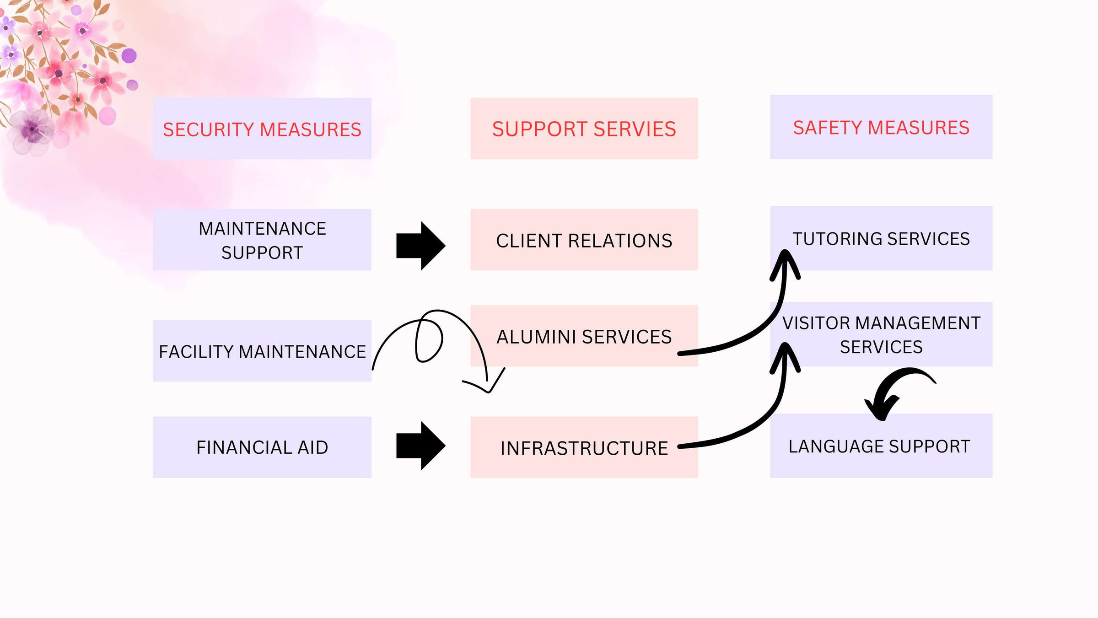

Slide 11





Mind mapping

Slide 12
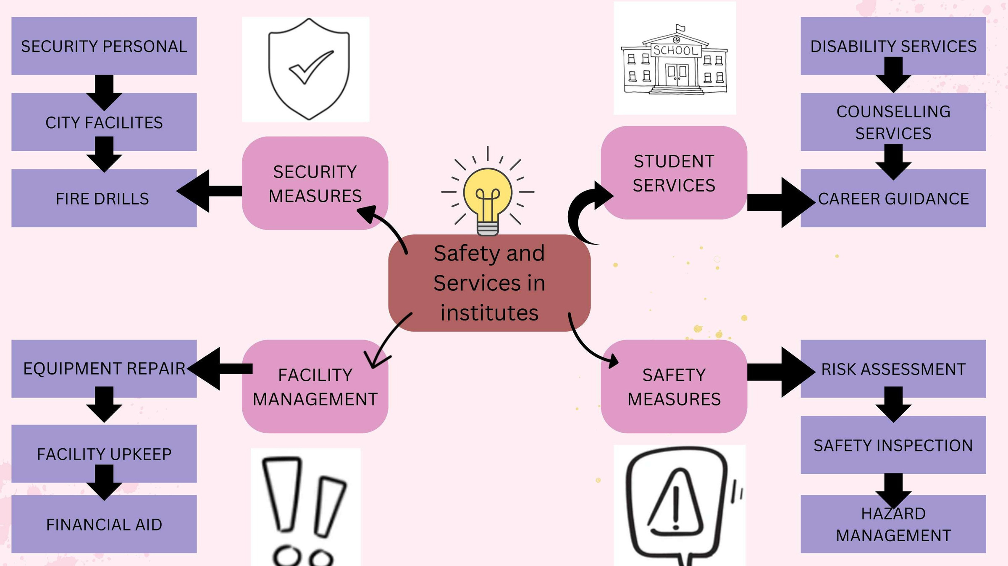

Slide 13
5-WsQuestions and
1-H Questions

Slide 14
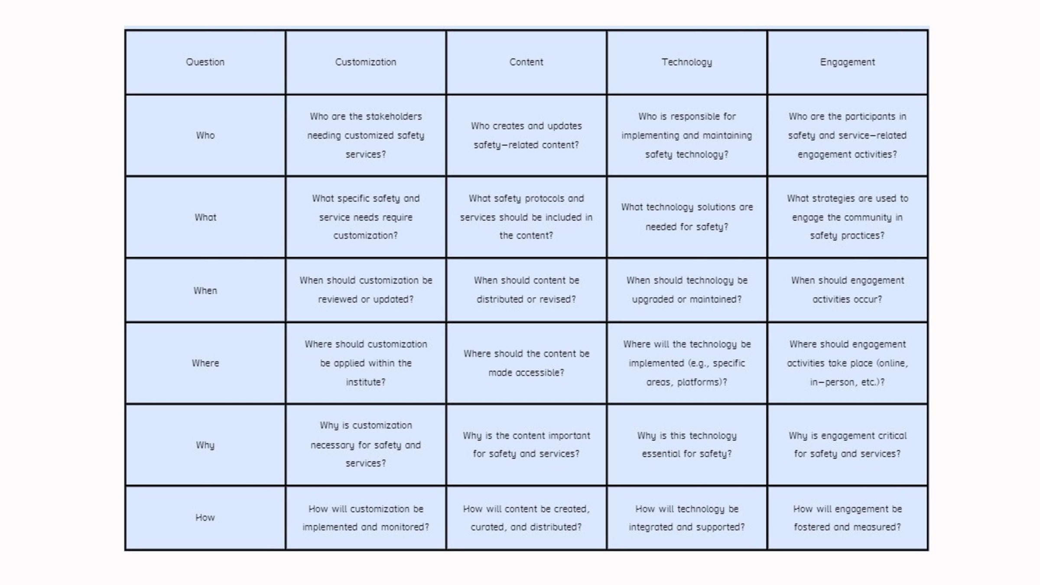

Slide 15
Users participants
Mapping

Slide 16
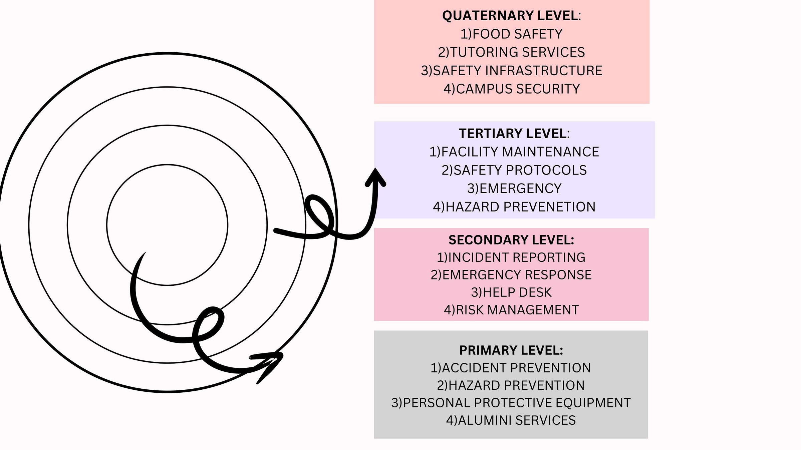

Slide 17
Demographics and
conceptual model

Slide 18


Slide 19
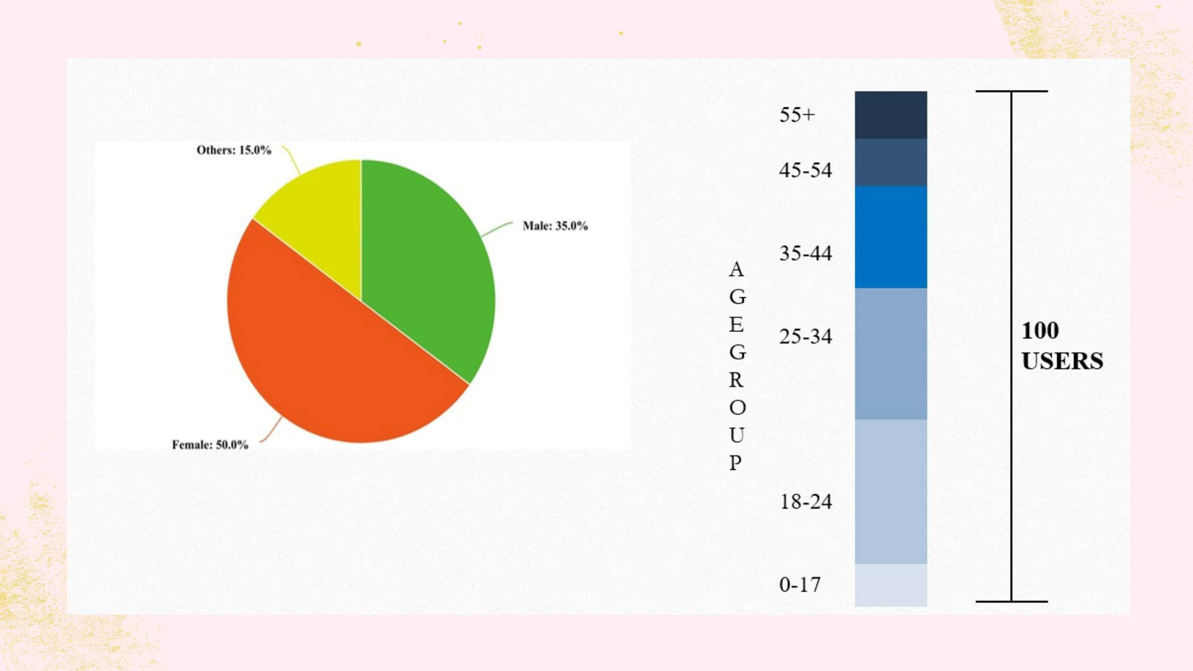

Slide 20


Slide 21
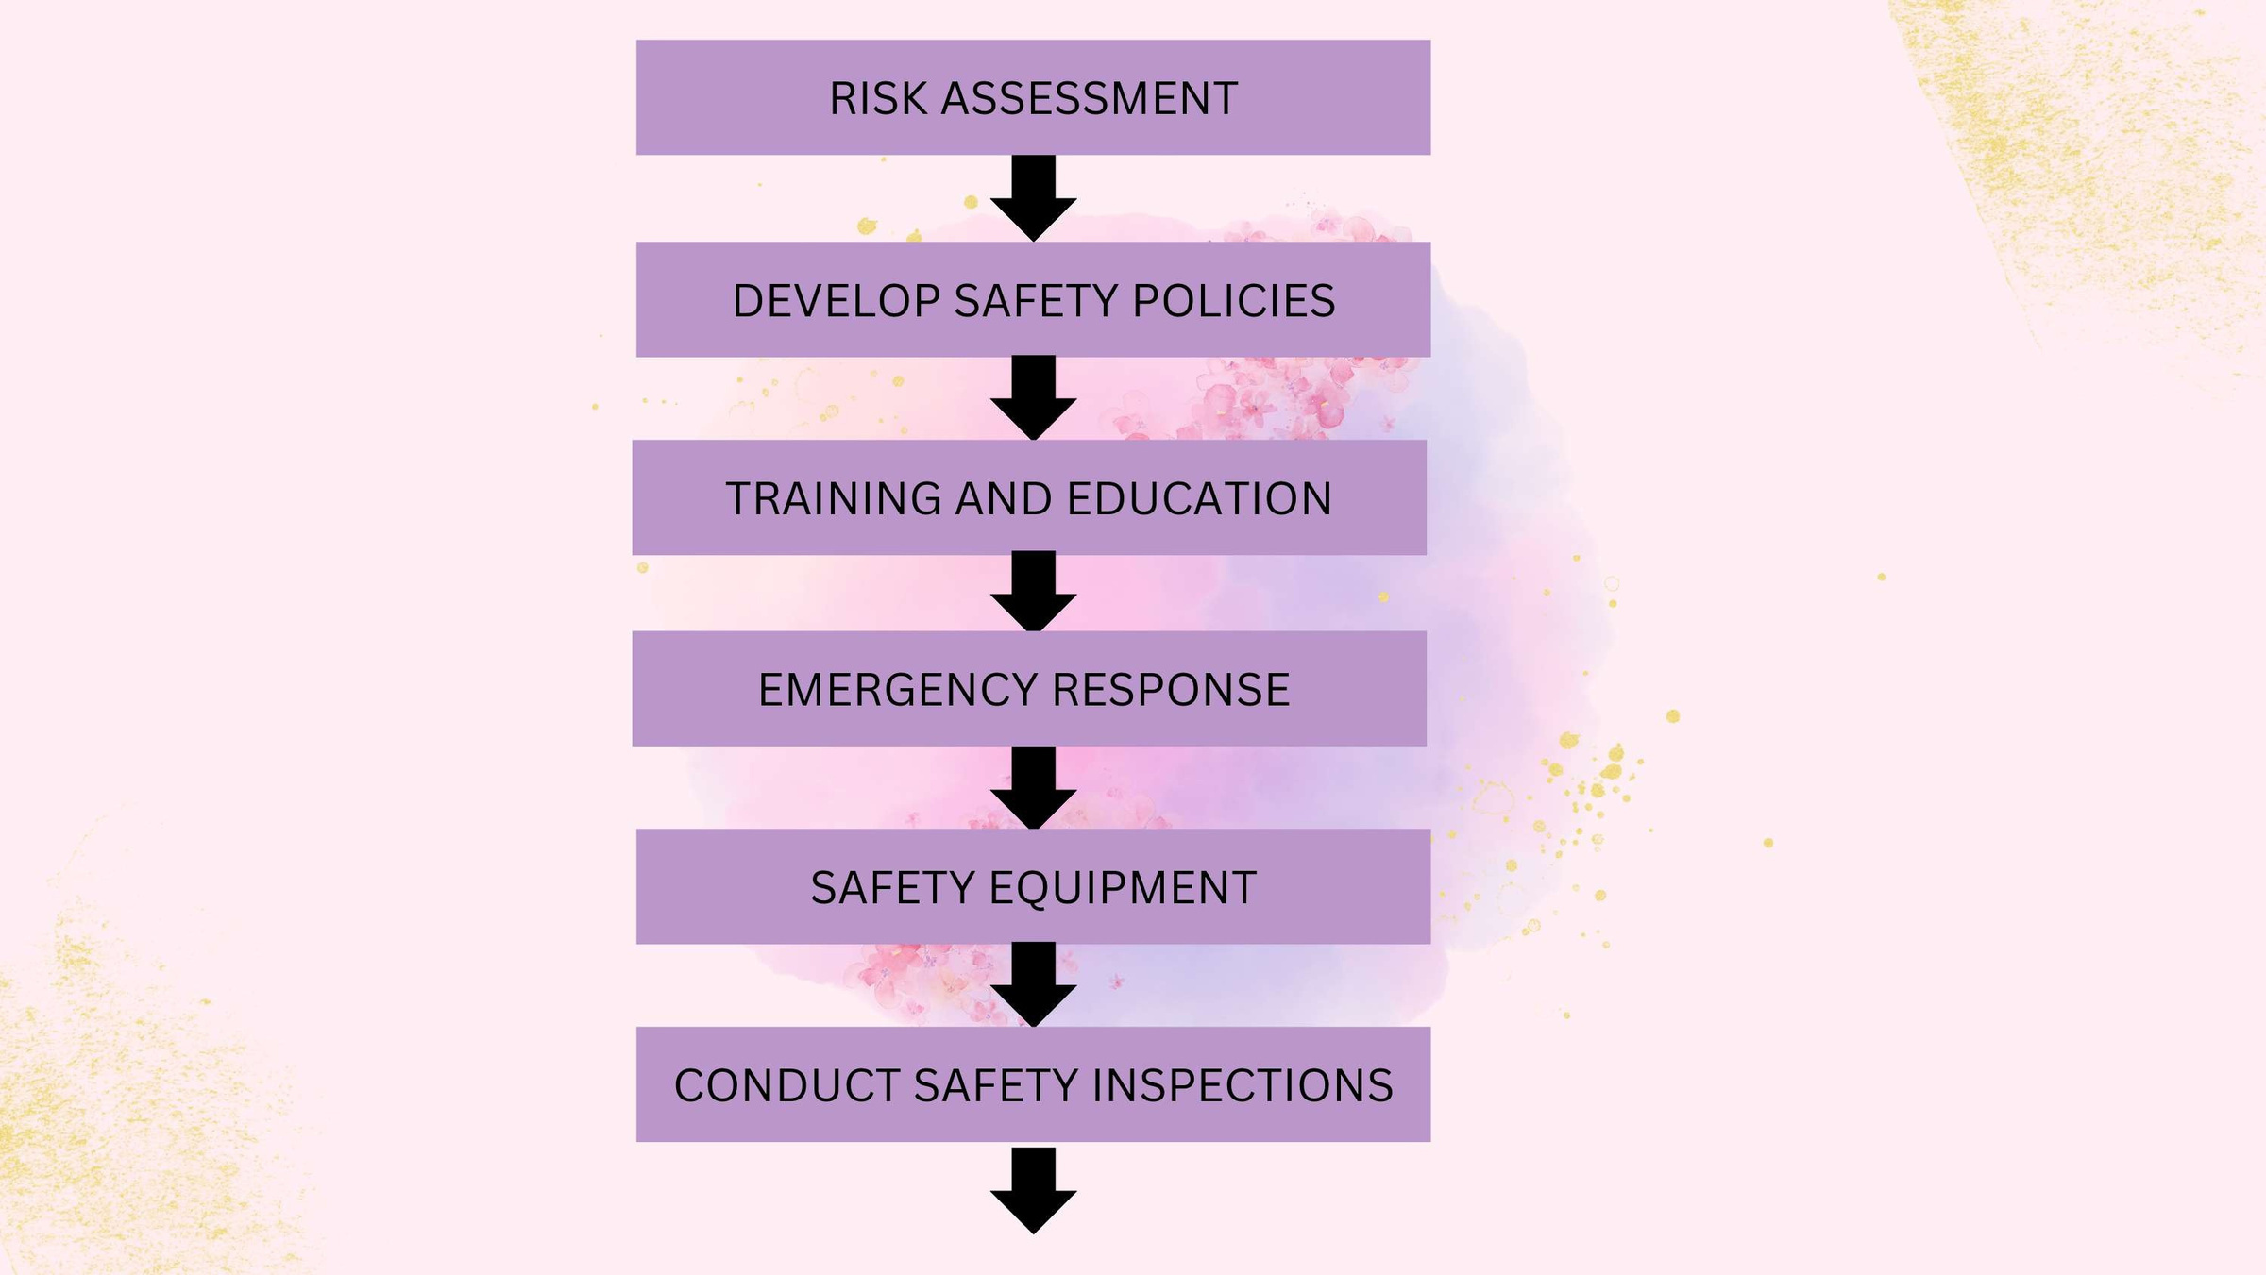

Slide 22
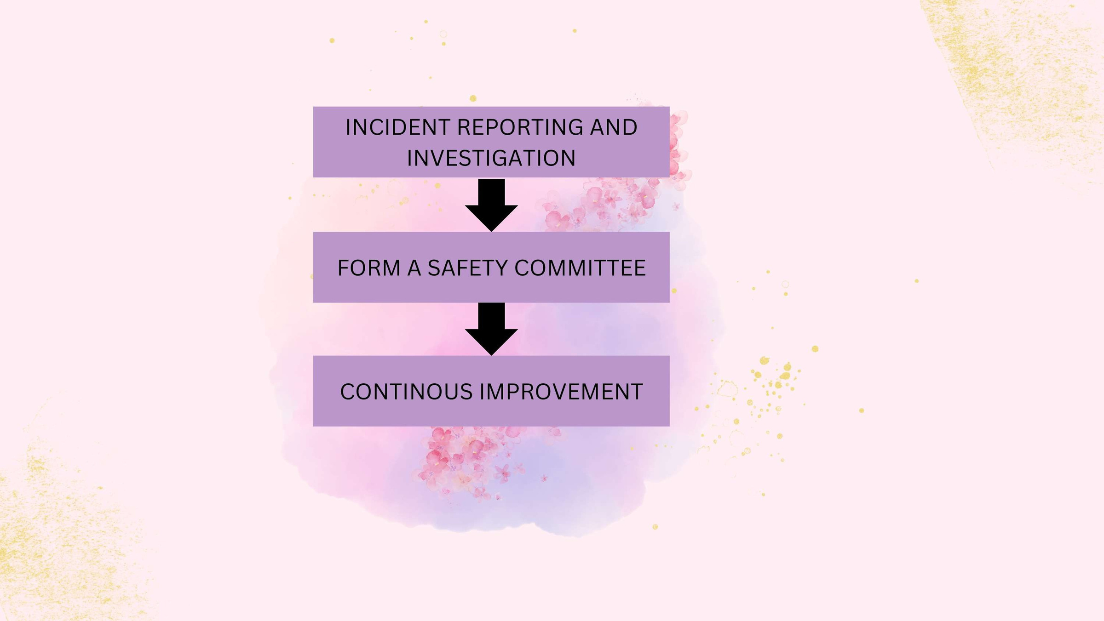

Slide 23
Questionnaries

Slide 24


Slide 25
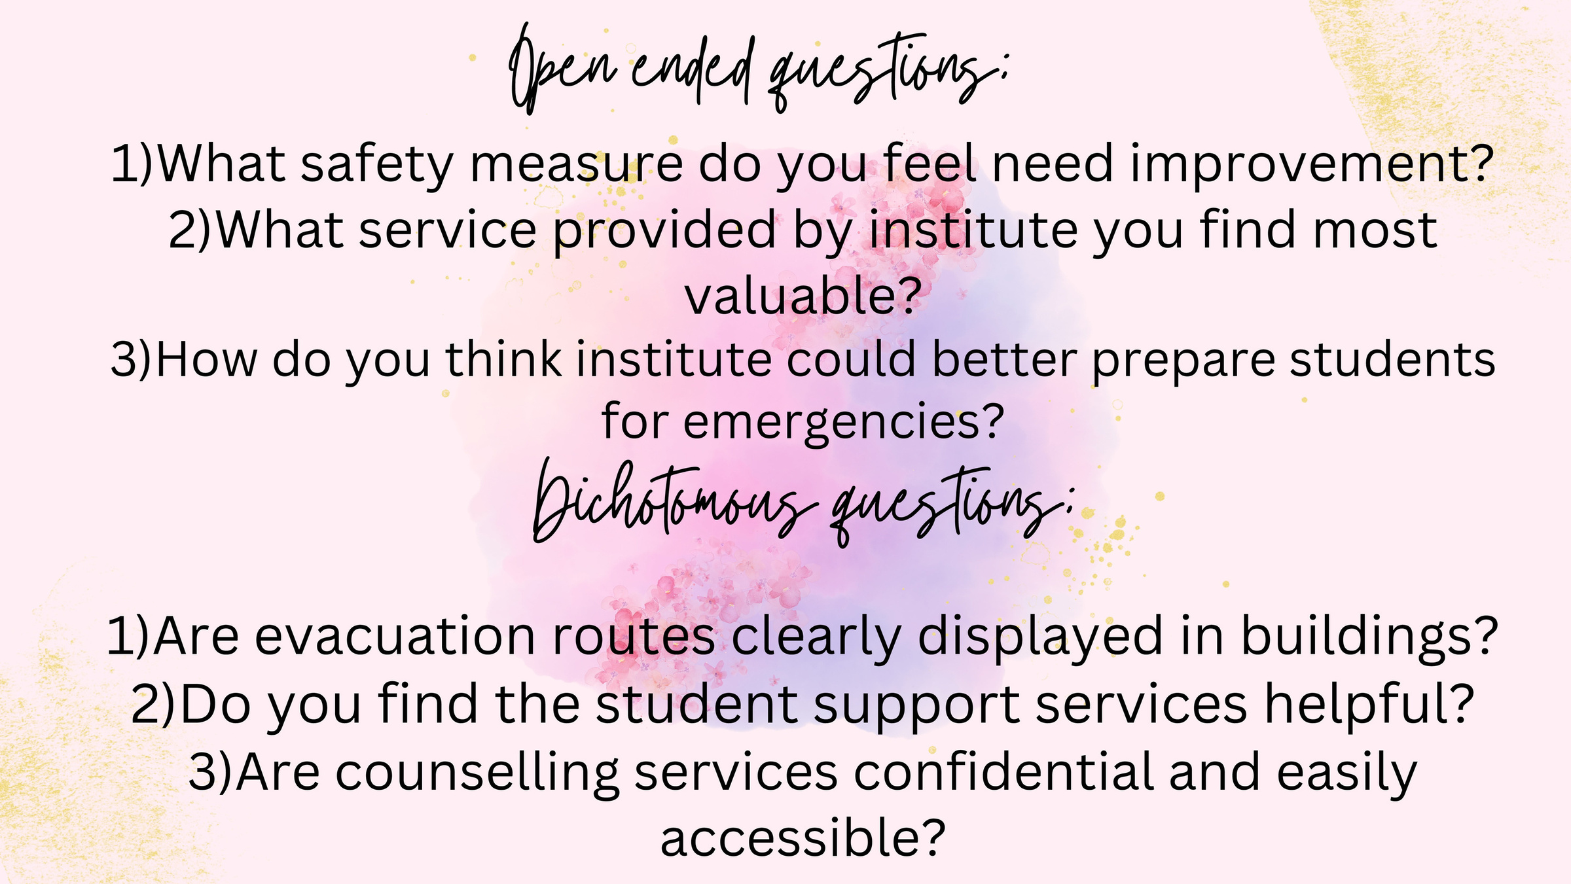

Slide 26
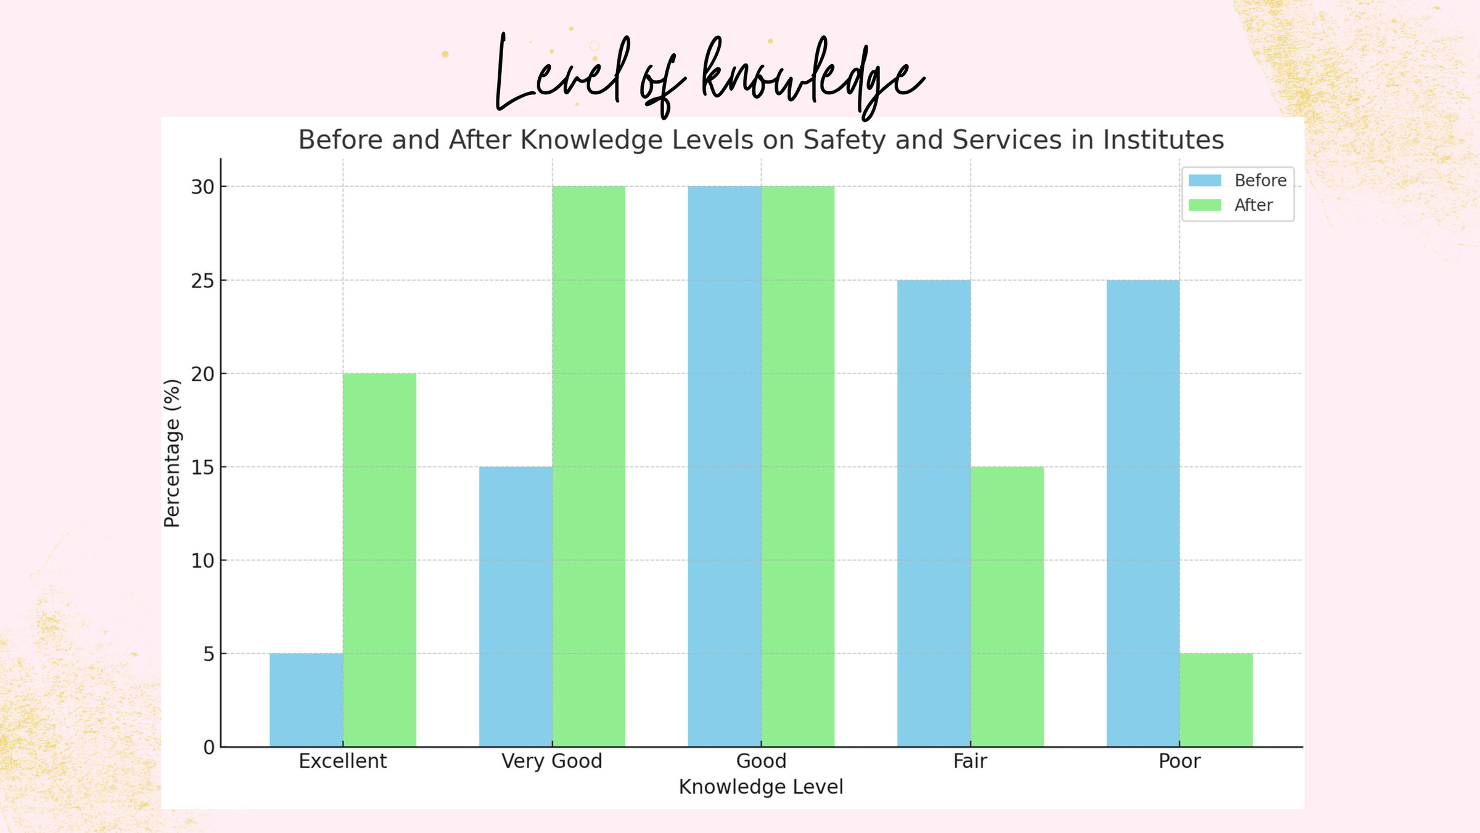

Slide 27


Slide 28
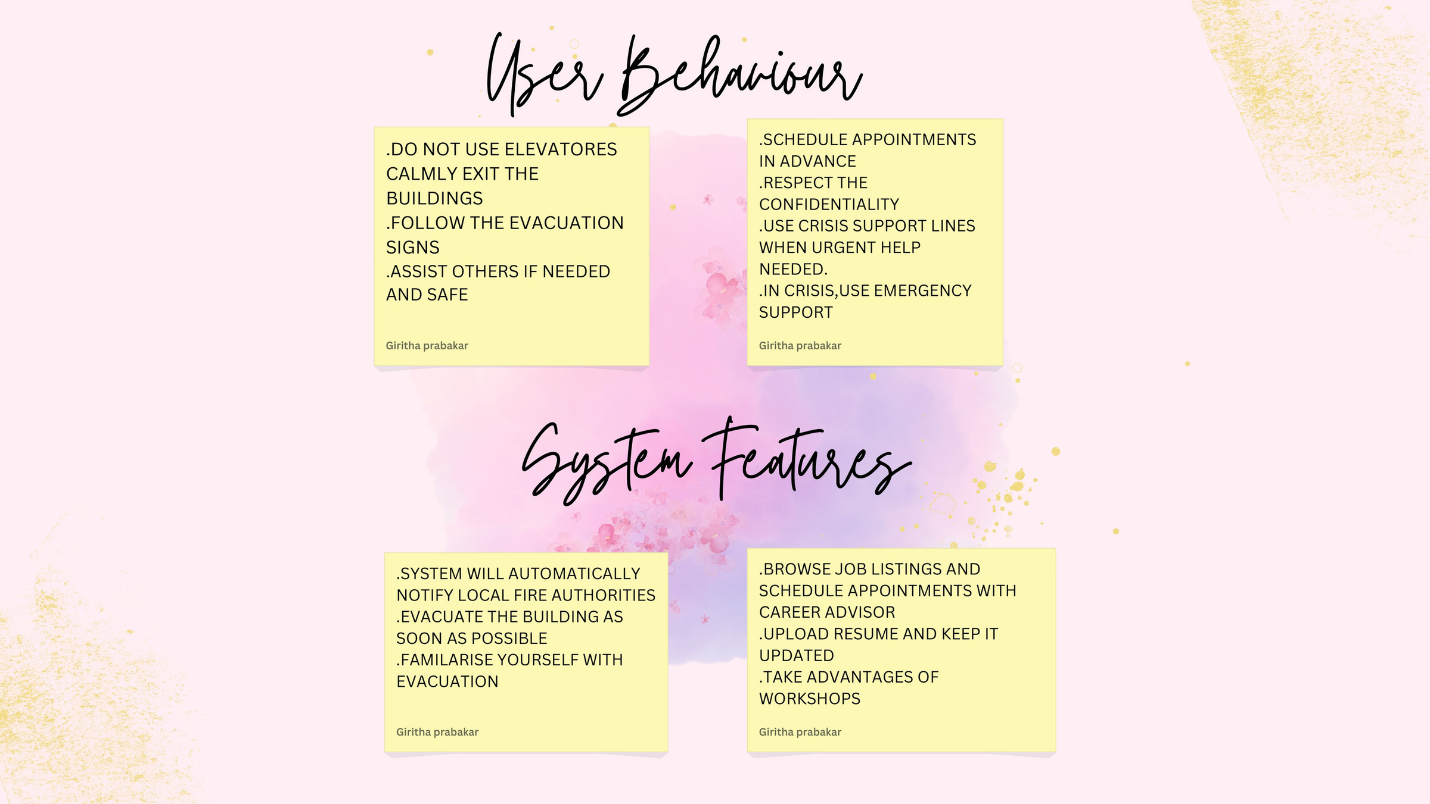

Slide 29
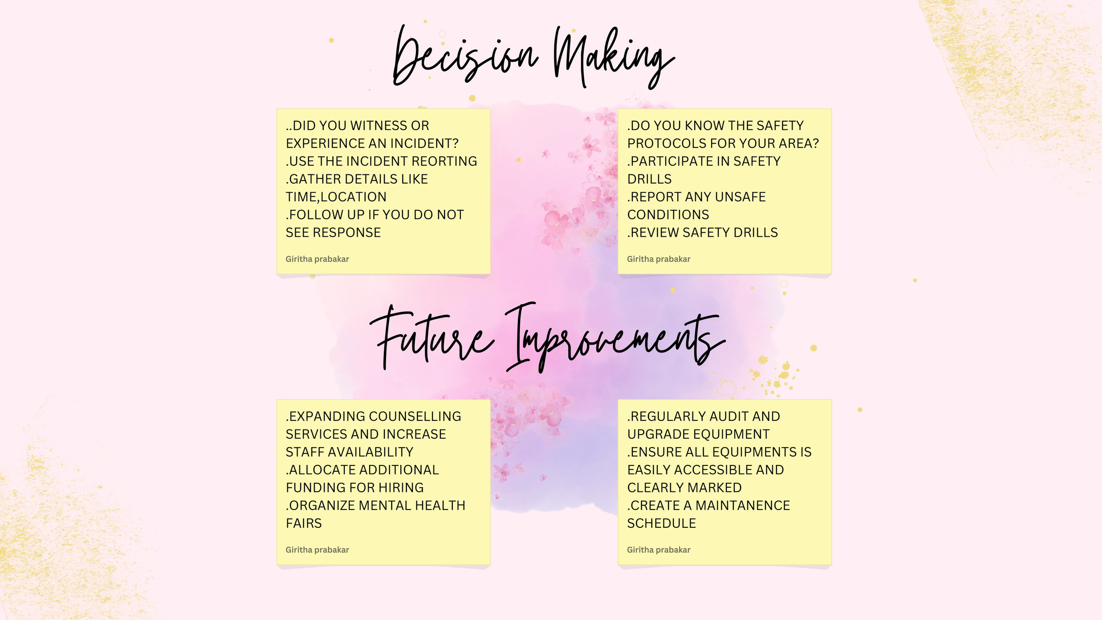

Slide 30
Activity Mapping

Slide 31
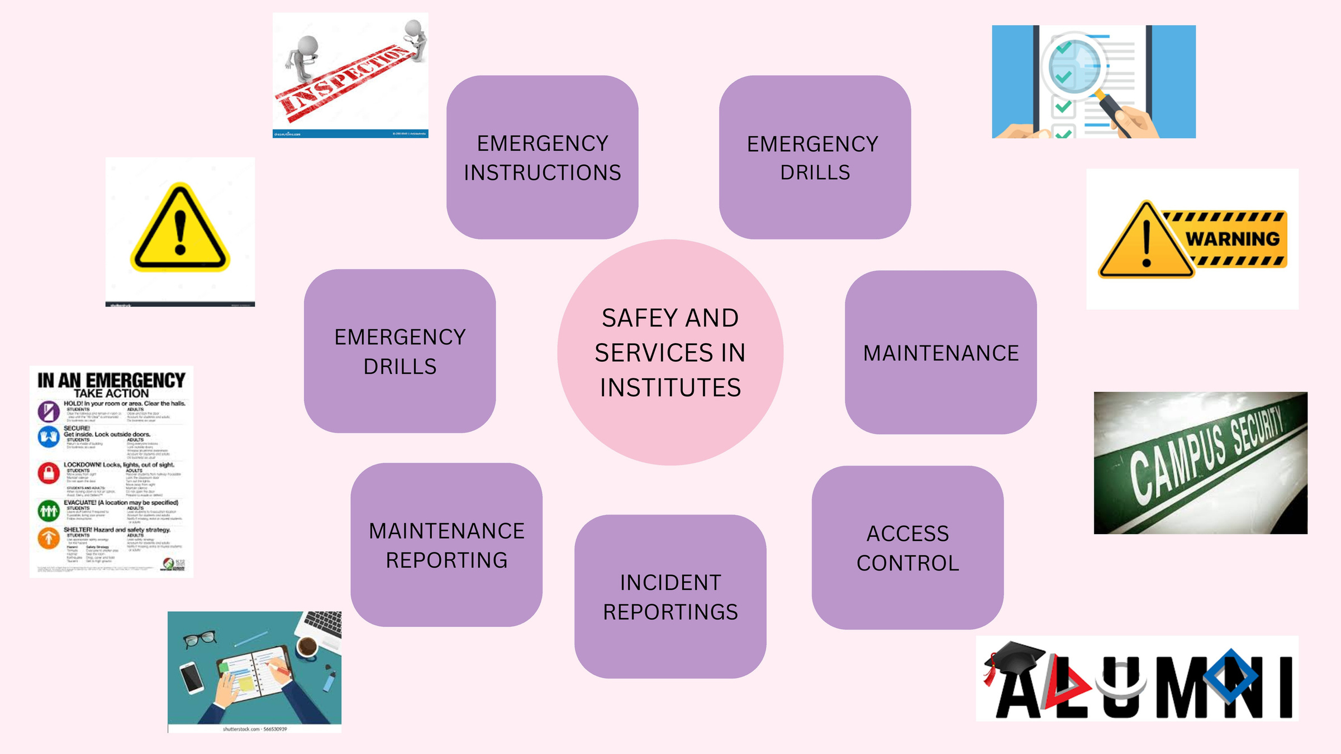

Slide 32
Personas and oior table

Slide 33
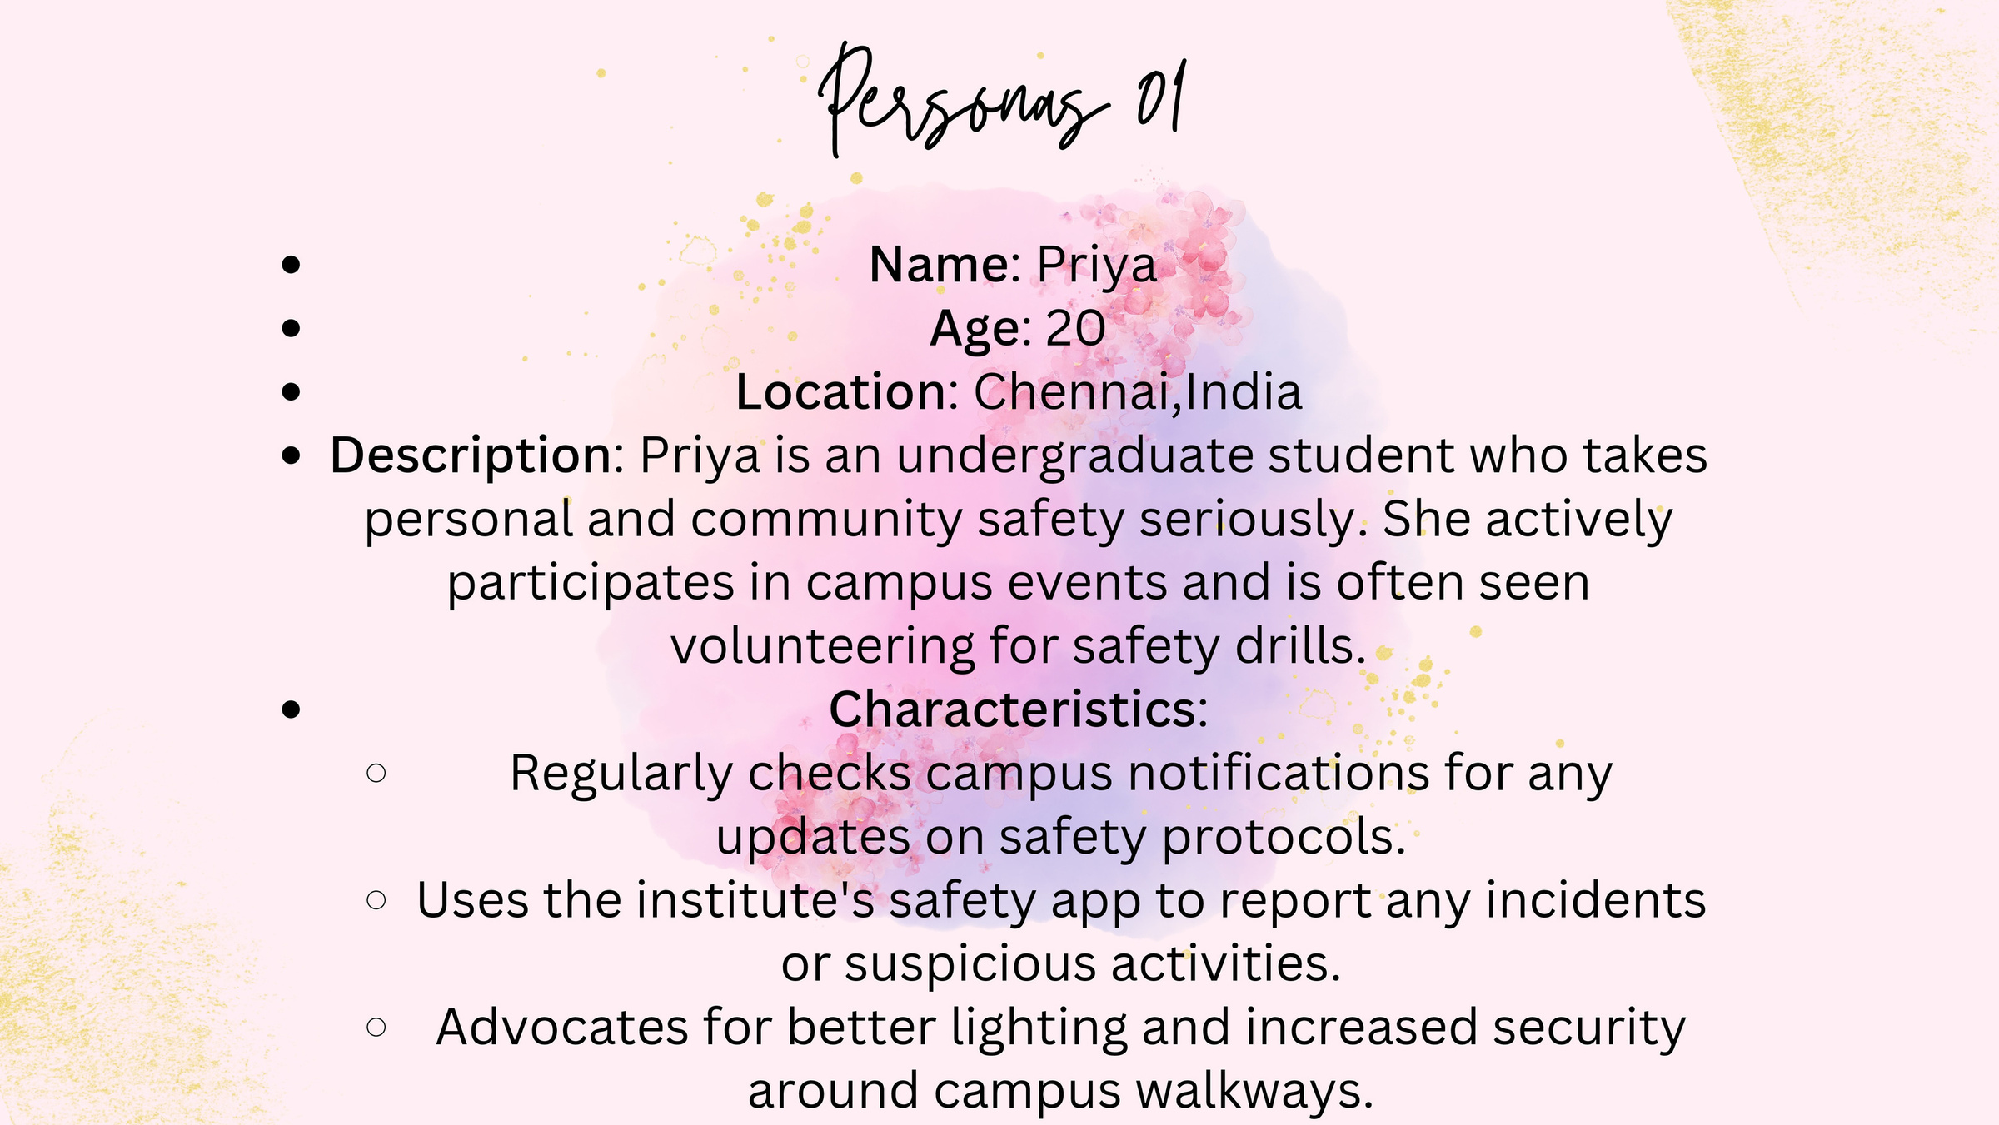

Slide 34
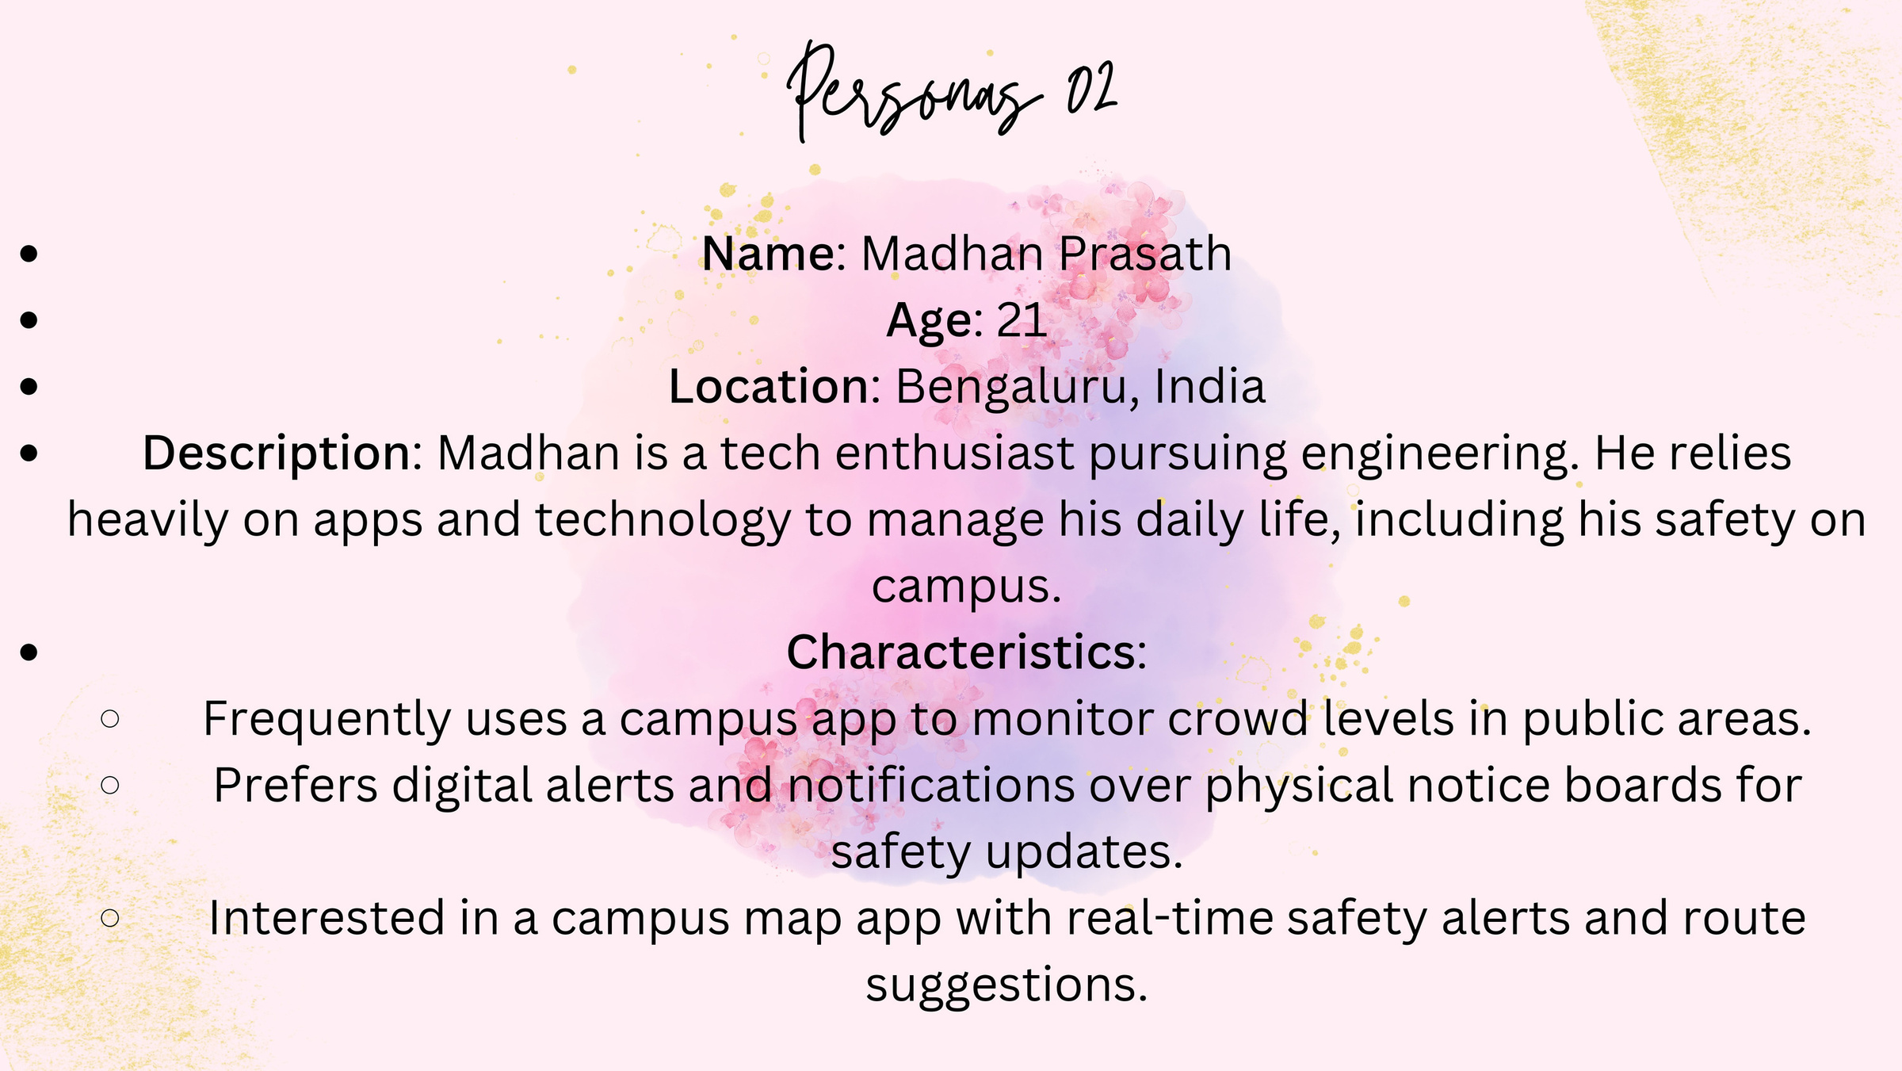

Slide 35
